Slide 1
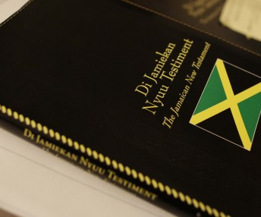
The Substance of the Bible
By C. Edwards

Slide 2
Questions about the bible:
Is the bible relevant for today's society?
How do I know the bible is true?
What does it mean that the bible is, becomes and contains the word of God?
Does the bible contradict itself?
Why is the bible so violent & why does it support slavery?
How do I know the bible is trust worthy?

Slide 3
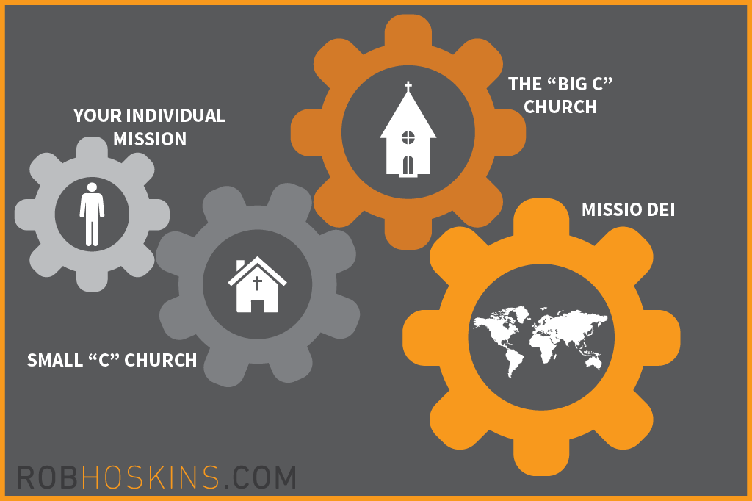
What is the bible?
It is call the book of books, and books within a book.
The bible is a book compiled throughout centuries, giving a historical narative of the salvation plan of God. Called the "Missio Dei" a latin phrase the means "The Mission of God."
The Bible is the Judeo-Christian worldview of God and human existence.

Slide 4
The credibility of the bible:
The Bible is Coherent:
Biblical coherence means Biblical synthesis or what is called the synthetic principle. The bible should be understood as a library of 66 books that collected together, and it becomes one book. “Scripture is its own interpreter.” “Scripture is to be compared with Scripture in order to discover its accurate and full meaning.”
Ravi Zacharias, sometime ago, while he was speaking, had a woman stand up and shout out, “Whoever told you that the world needs to be coherent? Where did you get this idea that life had to be coherent? “ In a rather humorous manner, Ravi replied, “Ma’am I’ll be very happy to answer your question, I just have one question for you. Do you want my answer to be coherent or incoherent?”
Coherence matters, because its speaks to true logic and consistency.

Slide 5
The credibility of the bible:
Truth is what corresponds to reality. Consequently, what is real is true, what is unreal is false.
If what the bible says corresponds to reality it measures up to truth.
The Bible makes some very distinctive truth claims. It claims, for instance, that God exist. It also claims that He has chosen to communicate with us through His creation, our moral conscience, and through the Bible.
These claims the Bible makes either correspond to reality or they do not. Christians believe that they do correspond to reality, meaning that the Bible is true.

Slide 6
The credibility of the bible:
Truth is what corresponds to reality. Consequently, what is real is true, what is unreal is false.
If what the bible says corresponds to reality it measures up to truth.
The Bible makes some very distinctive truth claims. It claims, for instance, that God exist. It also claims that He has chosen to communicate with us through His creation, our moral conscience, and through the Bible.
These claims the Bible makes either correspond to reality or they do not. Christians believe that they do correspond to reality, meaning that the Bible is true.

Slide 7
The credibility of the bible:
Truth is what corresponds to reality. Consequently, what is real is true, what is unreal is false.
If what the bible says corresponds to reality it measures up to truth.
The Bible makes some very distinctive truth claims. It claims, for instance, that God exist. It also claims that He has chosen to communicate with us through His creation, our moral conscience, and through the Bible.
These claims the Bible makes either correspond to reality or they do not. Christians believe that they do correspond to reality, meaning that the Bible is true.

Slide 8
The credibility of the bible:
Truth is what corresponds to reality. Consequently, what is real is true, what is unreal is false.
If what the bible says corresponds to reality it measures up to truth.
The Bible makes some very distinctive truth claims. It claims, for instance, that God exist. It also claims that He has chosen to communicate with us through His creation, our moral conscience, and through the Bible.
These claims the Bible makes either correspond to reality or they do not. Christians believe that they do correspond to reality, meaning that the Bible is true.

Slide 9
The credibility of the bible:
Historical Support by christian and non-christian historians and archiologist.
Archeologist and historical researchers consult the bible first for geographical location and direction.
Prophetic Fulfillment of declarations within the OT & NT.
(Jesus' incarnation, Ressurection, Johns Apocalypse, etc.)

Slide 10
The Inspiration of the bible:
The bible is the word of God
The bible becomes the word of God
The bible contains the word of God

Slide 11
The Inspiration of the bible:
These are positions held by christians in different periods over history.
Orthodox holds that the bible is the word of God (verbal/every word).
Modernism holds that the bible contains the word of God. Saying certain parts are true and divine while others are not.

Slide 12
The Inspiration of the bible:
Neoorthodoxy holds that the bible becomes the word of God. To mean the scripture becomes the word of God in their personal experience with it.

Slide 13
2 Timothy 3:1-17 the relevance of the word for the day

